Slide 1

Data Science Analysis on Global Superstore Sales Dataset
By: Kartik Sharma

Slide 2

Data Cleaning
Converting data into relevant datatype for instance date into datetime format for further analysis.
Dropping irrelevant features like customer id and customer name which are not that useful in finding the business insights.

Slide 3

EDA(Exploratory Data Analysis)
In this step we take a deeper look of the data by analyzing the data using numpy and pandas functions like head(), tail(), shape etc.
We group the aggregates line price and sales by using groupby() functions and finding the trends by applying various filter operations like sum(), mean(), min().

Slide 4

Feature Engineering
The very first thing we did is checking for outliers and handled them, in our case we didn’t do anything because all the points in our boxplot are outliers.
After that we created some features for our efficient analysis that are profit margin, profit flag(it tells whether our profit is positive or negative) and sales category.

Slide 5
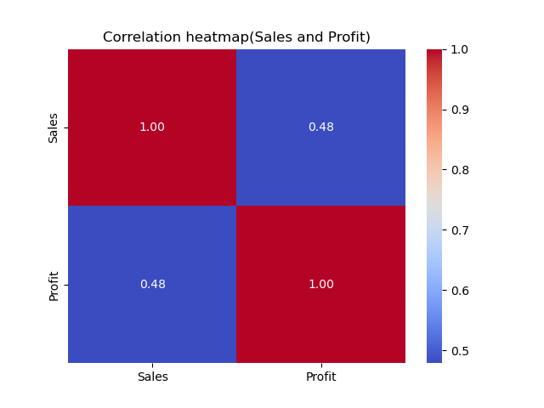
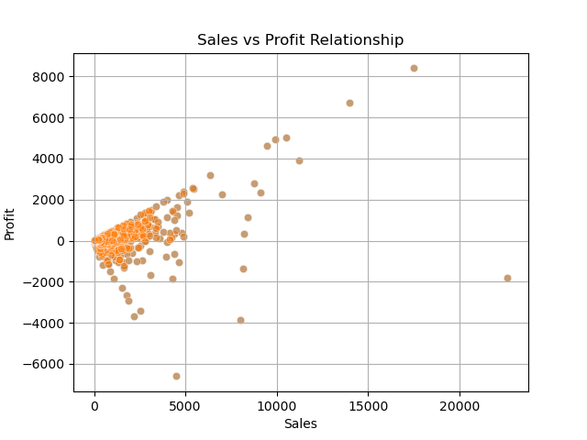
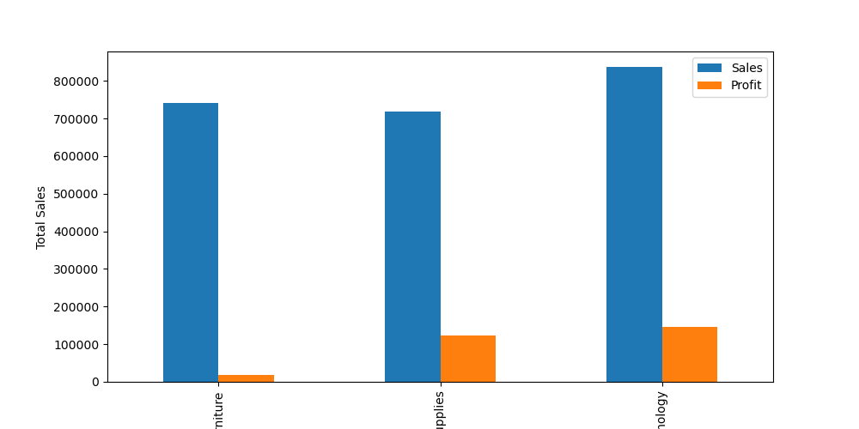
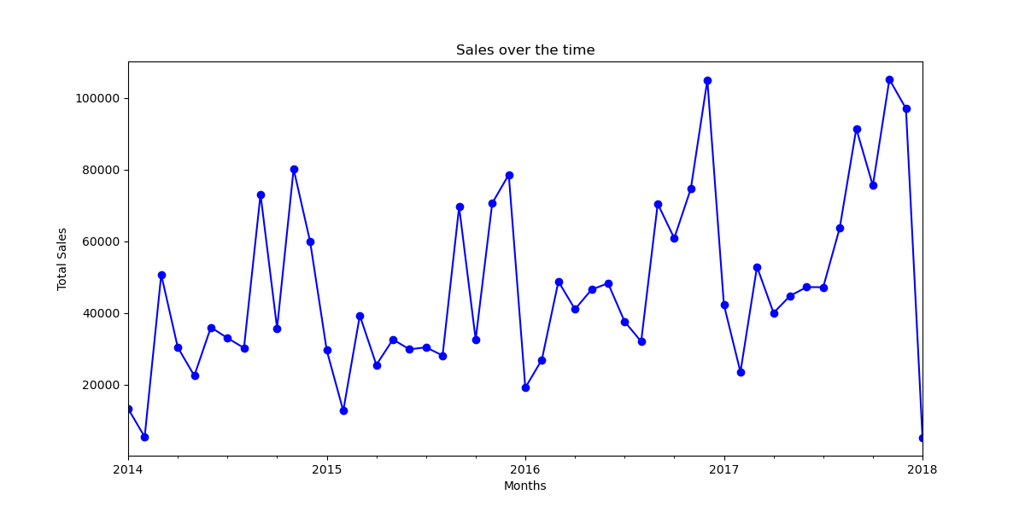
Data Visualizations
The first plot is correlation heatmap which is showing the correlation between profit and sales.
Then we have scatter plot which also shows correlation and the distribution of the data.
Line plot here is briefing about the sales over the time
At last here is a bar char which is showing us the category wise data distribution.

Slide 6

Analysis and Insights
The data reveals a strong correlation between Profit and Sales. A high profit margin is prevalent, indicating robust business performance with many products being sold at favorable prices. However, there are instances of negative margins, highlighting that some products were sold at a loss.
Analyzing sales trends over time, we observe significant fluctuations. Sales showed a steady upward trend until the end of 2017, followed by a sharp decline. The early months of 2018 represent the lowest sales period in the dataset.
Among all categories, the Technology segment stands out, delivering the highest profit margin compared to the other two categories.

